Slide 1

Homework 03
1. Expected net value of single film?
2. Expected net value for film + sequel?
3. SE for net value of film + sequel?
4. Recommended strategy?
5. Expected net value of profit-max. strategy?

Slide 2
Data
Films cost $76M
22% chance of $222M, 78% chance of $30M
Sequels
Cost $95M (same time) or $122M (after)
90% chance for same result, 10% for opposite
Q1: EV(single film)
= –76M + (222M)(0.22) + (30M)(0.78)
= –3.76M

Slide 3
Data
Films cost $76M
22% chance of $222M, 78% chance of $30M
Sequels
Cost $95M (same time) or $122M (after)
90% chance for same result, 10% for opposite
Film + sequel:
2nd film?
Hit
0.90
–76+222–95+222 = 273 w/ prob 0.198
1st film?
Hit
0.22
-95M
Avg
0.10
–76+222–95+ 30 = 81 w/ prob 0.022
-76M
2nd film?
Avg
0.90
–76+ 30–95+ 30 = -111 w/ prob 0.078
Avg
0.78
-95M
Hit
0.10
–76+ 30–95+222 = 81 w/ prob 0.078

Slide 4
Net outcomes and probabilities
273M 0.198
81M 0.100
–111M 0.702
Q2: EV(film+sequel) = –$15.77M
EV = (273)(0.198) + (81)(0.100) + (–111)(0.702)
Q3: SE(film+sequel) = $154.32M
Q4: consider option …

Slide 5
Data
Films cost $76M
22% chance of $222M, 78% chance of $30M
Sequels
Cost $95M (same time) or $122M (after)
90% chance for same result, 10% for opposite
Film + sequel, option version:
Spend $122M … 2nd film?
Hit
0.90
–76+222–122+222 = 246 w/ prob 0.198
1st film?
Hit
0.22
Avg
0.10
–76+222–122+30 = 54 w/ prob. 0.022
Avg
0.78
–76+30 = -46 w/ prob 0.78

Slide 6
Q4: Profit-maximizing strategy
Q5: EV(optimal strategy) = $14.02M
EV = (246)(0.198) + (54)(0.022) + (–46)(0.78)
Options have value (from -4M to +14M)
… be on the lookout for real options!
Hit
0.90
–76+222–122+222 = 246 w/ prob 0.198
1st film?
Hit
0.22
Avg
0.10
–76+222–122+30 = 54 w/ prob. 0.022
Avg
0.78
–76+30 = -46 w/ prob 0.78

Slide 7
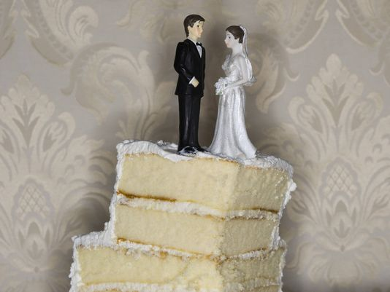
Homework 03
6. P(both husband and wife had doubts) = ?
7. P(husband has doubts | wife has doubts) = ?
8. Overall divorce rate among all couples?
9. Divorce rate when both had doubts?
10. Are H and W independent and/or mutually exclusive?

Slide 8
P(both husband and wife had doubts) = ?
P(husband has doubts) = 47.0%
P(wife has doubts) = 37.9%
P(both have doubts) = 21.1%
 | Husband
 | Husband has doubts | Husband has no doubts | Total
Wife has doubts | 21.1% | 16.8% | 37.9%
Wife has no doubts | 25.9% | 36.2% | 62.1%
Total | 47.0% | 53.0% | 100.0%

Slide 9
P(husband doubts | wife has doubts) =
= 21.1 / 37.9 = 55.7%
 | Husband
 | Husband has doubts | Husband has no doubts | Total
Wife has doubts | 21.1% | 16.8% | 37.9%
Wife has no doubts | 25.9% | 36.2% | 62.1%
Total | 47.0% | 53.0% | 100.0%

Slide 10
Overall divorce rate among all couples?
In each couple, either the wife has doubts, or she does not. The overall divorce rate is (0.379)(0.193) + (0.621)(0.063) = 0.112
Likewise, in each couple, either the husband has doubts, or he does not. Again, the overall divorce rate is (0.470)(0.138) + (0.530)(0.089) = 0.112

Slide 11
Divorce rate when both had doubts?
Overall # divorces = 0.112(464) = 52.1
# for women with doubts → (0.379)(0.193)(464) = 33.9
# for women w/o doubts → (0.621)(0.063)(464) = 18.2
# for men with doubts → (0.470)(0.138)(464) = 30.1
# for men w/o doubts → (0.530)(0.089)(464) = 21.9
# for couples, no doubts → (0.362)(0.060)(464) = 10.1
 | Husband
 | Husband has doubts | Husband has no doubts | Total
Wife doubts | 22.1 | 11.8 | 33.9
Wife has no doubts | 8.0 | 10.1 | 18.2
Total | 30.1 | 21.9 | 52.1

Slide 12
Divorce rate when both had doubts?
When both had doubts, # divorce ~ 22.1
# couples both doubt = (0.211)(464) ~ 97.9
Divorce rate when both had doubts = 22.1/97.9 = 22.6%
 | Husband
 | Husband has doubts | Husband has no doubts | Total
Wife doubts | 22.1 | 11.8 | 33.9
Wife has no doubts | 8.0 | 10.1 | 18.2
Total | 30.1 | 21.9 | 52.1

Slide 13
Are H and W independent and/or mutually exclusive?
H and W can both happen, so they are NOT mutually exclusive
Overall, P(wife has doubts) = 0.379; but if husband has doubts, P(W | H) = 0.211 / 0.47 = 0.449, an increase, so NOT independent
Any questions on HW03?

Slide 14
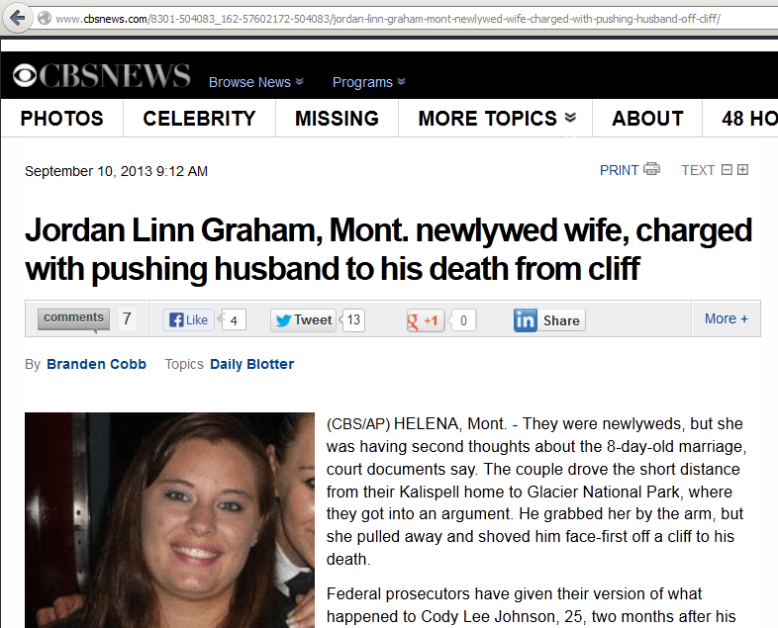
PS It may be important to know if you partner has doubts
“They were newlyweds, but she was having second thoughts about the 8-day-old marriage …and shoved him face-first off a cliff to his death.”

